Slide 1

Crime Prevention Surveillance with Technology
Explore the powerful role of technology in enhancing crime prevention and public safety, from cutting-edge software to state-of-the-art hardware.

Slide 2

The Role of Technology in Crime Prevention
Real-Time Monitoring
Surveillance systems that detect and alert authorities to suspicious activity
Predictive Analytics
Using data and machine learning to forecast and preempt criminal behavior
Automated Response
Coordinated systems that can rapidly dispatch law enforcement to incident locations
Evidence Collection
Cameras and sensor that provide crucial data for investigations

Slide 3
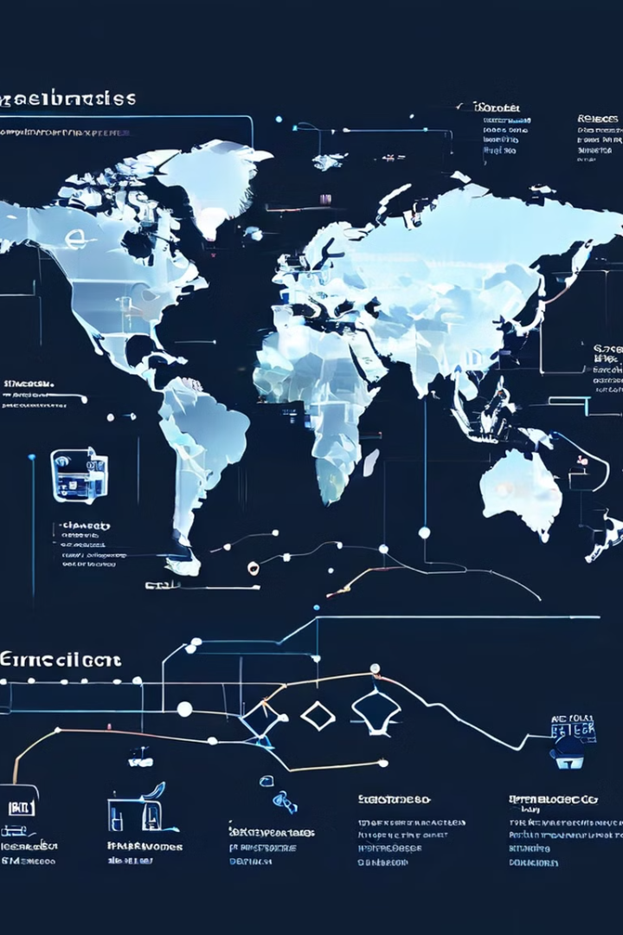
Machine Learning Techniques for Surveillance
1
Object Detection
Identify and track people, vehicles, and other objects of interest
2
Anomaly Detection
Recognize unusual patterns that may indicate criminal activity
3
Behavior Analysis
Interpret human movements and interactions to flag suspicious behavior

Slide 4





Deep Learning Applications in Surveillance
Facial Recognition
Identify individuals in real-time for security and investigation purposes
License Plate Detection
Track vehicle movements and associations for law enforcement needs
Activity Classification
Classify human actions and behaviors to detect suspicious activities
Predictive Analytics
Forecast crime patterns and hot spots to enable proactive policing

Slide 5

Motion Detection and Anomaly Identification
1
Motion Tracking
Detect and follow the movements of people and objects in real-time
2
Anomaly Detection
Identify unusual or suspicious behaviors that deviate from normal patterns
3
Intelligent Alerts
Trigger immediate notifications to authorities for rapid response
4
Adaptive Algorithms
Continuously learn and refine detection capabilities over time

Slide 6




Video Analytics and Behavior Monitoring
Object Tracking
Follow the movements of people, vehicles, and other objects
Behavior Analysis
Interpret human actions and interactions to detect potential threats
Situational Awareness
Gain a comprehensive understanding of the environment and events

Slide 7
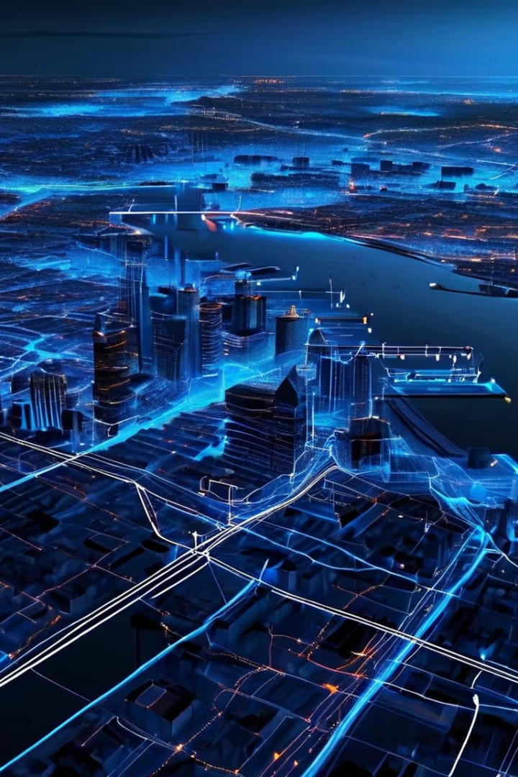
Predictive Policing and Crime Forecasting
1
Data Collection
Gather historical crime data, demographic information, and other relevant sources
2
Predictive Modeling
Apply machine learning algorithms to identify patterns and forecast future crime
3
Targeted Deployment
Allocate resources and deploy law enforcement to high-risk areas proactively

